Slide 1

Week #2
AI Academy®
1
Day 1:
Block Level Elements vs Inline Elements
HTML Tag vs Element
HTML Image & Link
Reviews & Feedbacks

Slide 2
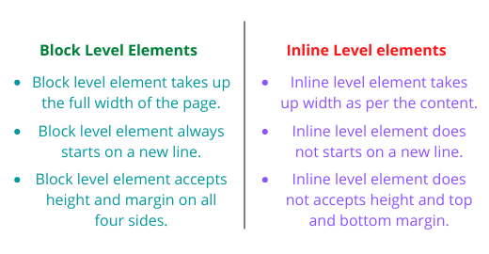
Week #2
AI Academy®
Difference Between Block or Inline Elements:
2

Slide 3
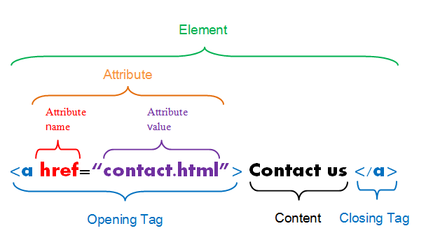
Week #2
AI Academy®
Difference Between Tag or Element:
3

Slide 4
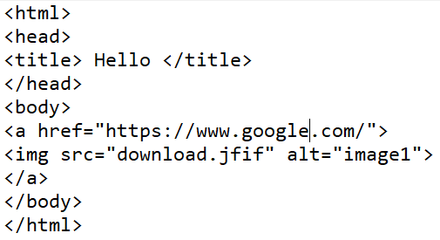
Week #2
AI Academy®
Difference Between Image or Link:
4

Slide 5
Week #2
AI Academy®
5
Day 2:
HTML Tables and Different Layouts
HTML Lists and Different Layouts
Reviews & Feedbacks

Slide 6
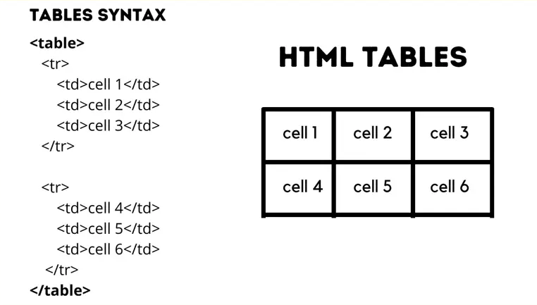
Week #2
AI Academy®
Tables:
6

Slide 7
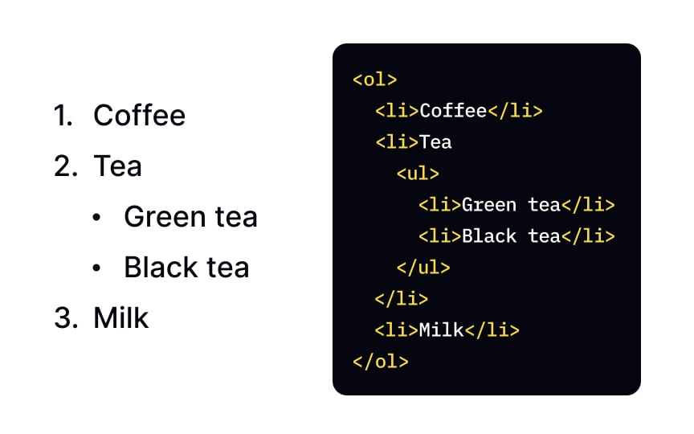
Week #2
AI Academy®
Lists:
7

Slide 8
Week #2
AI Academy®
8
Day 3:
HTML Forms
Different Types and Data Validations
Dynamic Properties
Reviews & Feedbacks

Slide 9
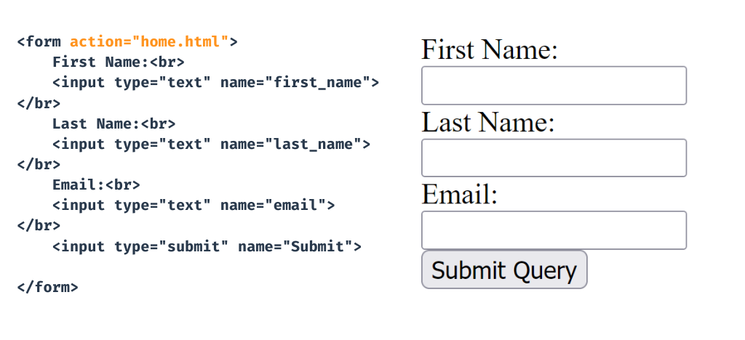
Week #2
AI Academy®
Forms:
9

Slide 10
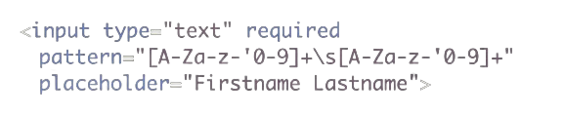
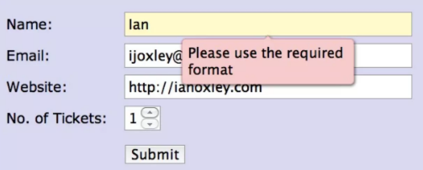
Week #2
AI Academy®
Forms Validations:
10

Slide 11
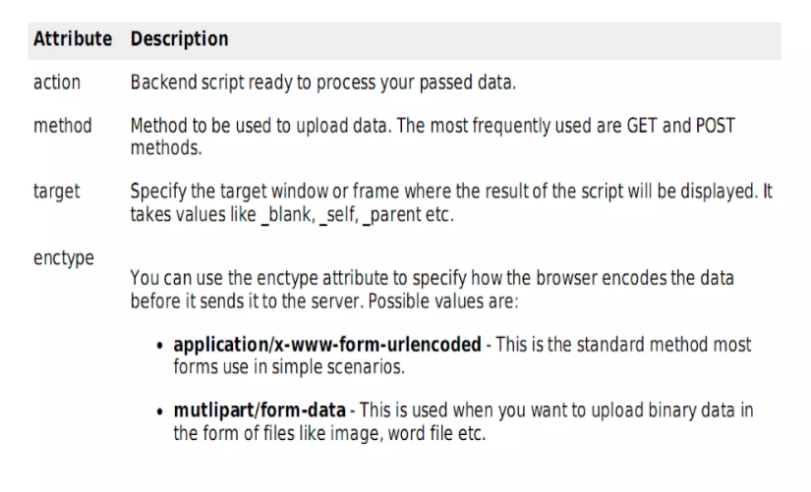
Week #2
AI Academy®
Dynamic Form Attributes:
11

Slide 12
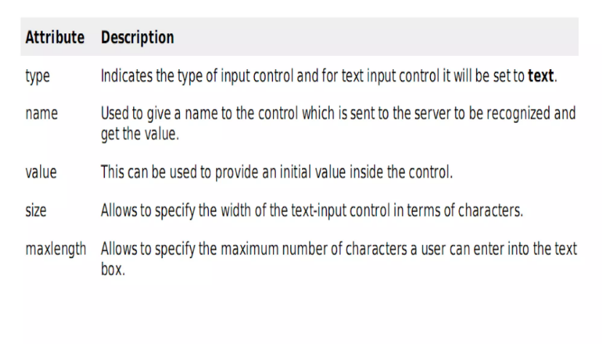
Week #2
AI Academy®
Dynamic Text Attributes:
12

Slide 13
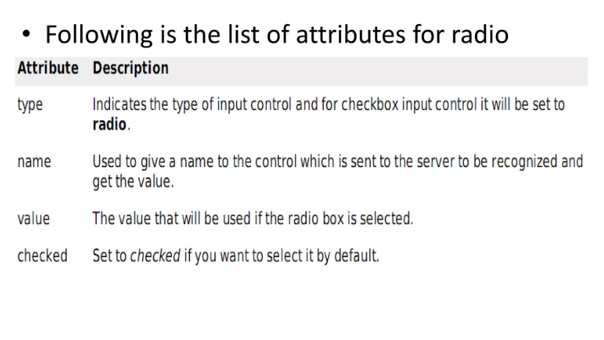
Week #2
AI Academy®
Dynamic Radio Attributes:
13

Slide 14
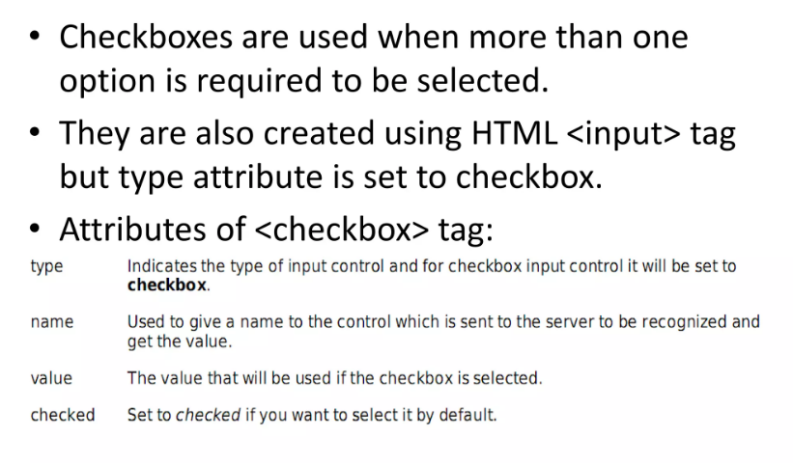
Week #2
AI Academy®
Dynamic Checkbox Attributes:
14

Slide 15
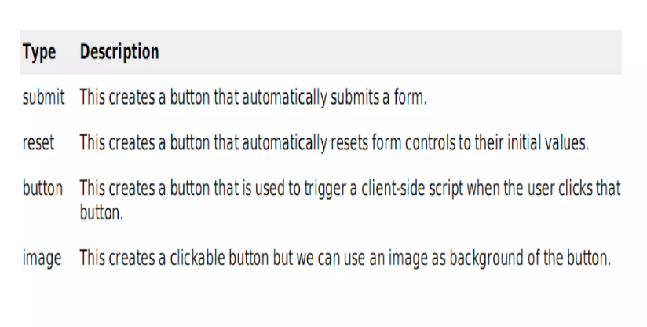
Week #2
AI Academy®
Dynamic Button Attributes:
15

Slide 16
Week #2
AI Academy®
16
Day 4:
HTML Layout Elements
HTML Iframe
HTML Media Elements
Reviews & Feedbacks

Slide 17
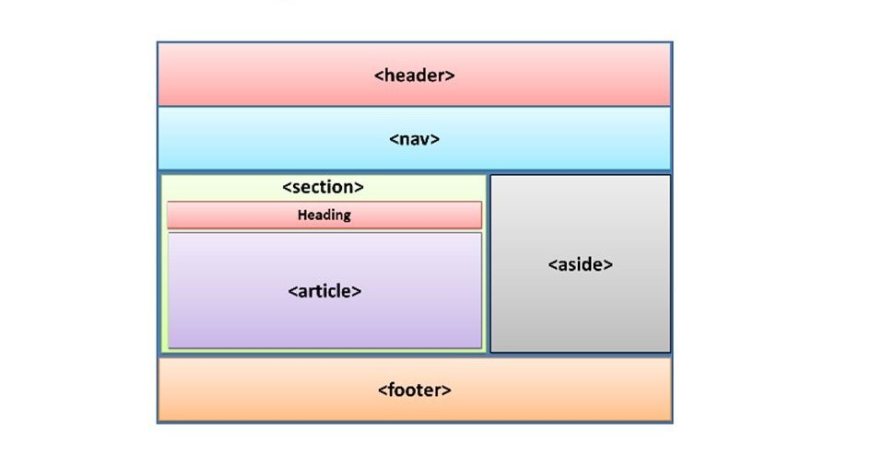
Week #2
AI Academy®
HTML Layout Elements:
17

Slide 18
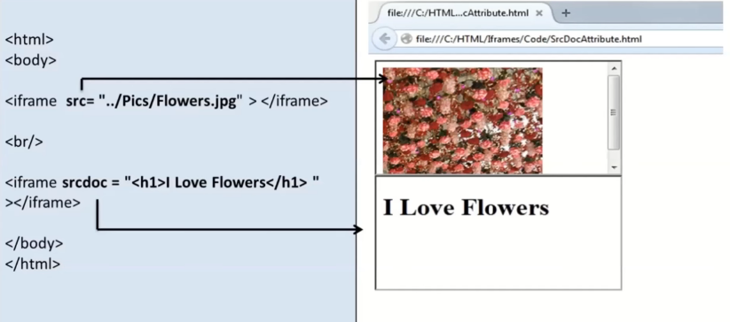
Week #2
AI Academy®
iFrame Element:
18

Slide 19
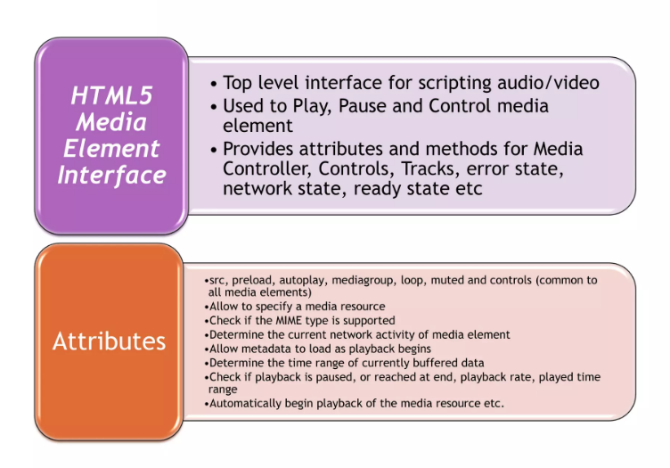
Week #2
AI Academy®
Media Element:
19

Slide 20
Week #2
AI Academy®
20
Day 5:
What is CSS?
CSS Syntax
Selector Types
Reviews & Feedbacks

Slide 21
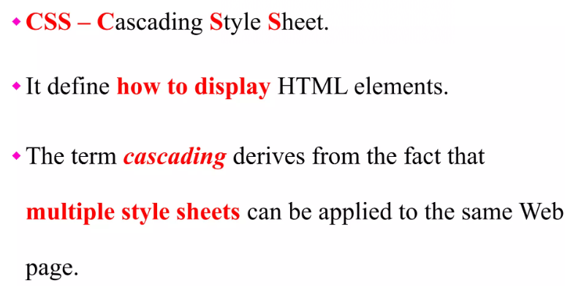
Week #2
AI Academy®
What is CSS?
21

Slide 22
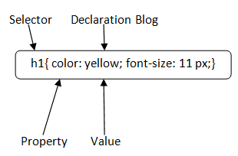
Week #2
AI Academy®
CSS Syntax or Selector:
22

